Slide 1
SPRING VALLEY VILLAGE POLICE DEPARTMENT
MONTHLY NEWSLETTER:
NOVEMBER 2024
1025 CAMPBELL ROAD
HOUSTON, TX 77055
PHONE: 713-465-8323
COMMUNITY MATTERS.
WE ARE A TEAM.

Slide 2
INTRODUCTION
Hilshire Village Residents,
Fall is officially upon us. Hopefully, everyone is enjoying the cooler weather and gearing up for the holidays.
KEEP IN MIND:
Be sure to lock all doors and windows in your home, when you are not on the premises.
Lock your vehicle when it is unoccupied.
If you see something, say something.
As always we are here if you need us.
Sincerely,
Chief M. Schulze
1025 CAMPBELL ROAD, HOUSTON, TX 77055
PHONE: 713-465-8323 / EMAIL: DISPATCH@SPRINGVALLEYTX.COM

Slide 3
NOVEMBER 2024
DATE | DAY | SPECIAL DAYS FOR THIS MONTH
NOVEMBER 03, 2024 | SUNDAY | DAYLIGHT SAVINGS ENDS
NOVEMBER 05, 2024 | TUESDAY | ELECTION DAY
NOVEMBER 10, 2024 | SUNDAY | MARINE CORPS BIRTHDAY
NOVEMBER 11, 2024 | MONDAY | VETERANS DAY
NOVEMBER 28, 2024 | THURSDAY | THANKSGIVING
COMMUNITY MATTERS.
WE ARE A TEAM.
1025 CAMPBELL ROAD, HOUSTON, TX 77055 / PHONE: 713-465-8323 / EMAIL: DISPATCH@SPRINGVALLEYTX.COM

Slide 4
Suspicious Activity
If you observe anything that you may feel is suspicious, you can call our non-emergency line 713-465-8323.
Example of Suspicious Activity:
An individual peering into vehicle, to try and locate any valuables left unattended
An individual trying door handles to vehicles, and/or residences to gain access to the vehicle and/or residence
An individual checking front doors of residences to locate any unattended packages, or individuals following delivery trucks to see where the truck is dropping off packages.
A vehicle is parked in an odd location or for a long period of time.
Add our non-emergency number to your cell phone for quick access.
Give as much detail as possible for the person or vehicle. (color of clothing, type of vehicle, etc.)
Do not follow the vehicle or person for your own safety.
COMMUNITY MATTERS.
WE ARE A TEAM.
1025 CAMPBELL ROAD, HOUSTON, TX 77055 / PHONE: 713-465-8323 / EMAIL: DISPATCH@SPRINGVALLEYTX.COM

Slide 5
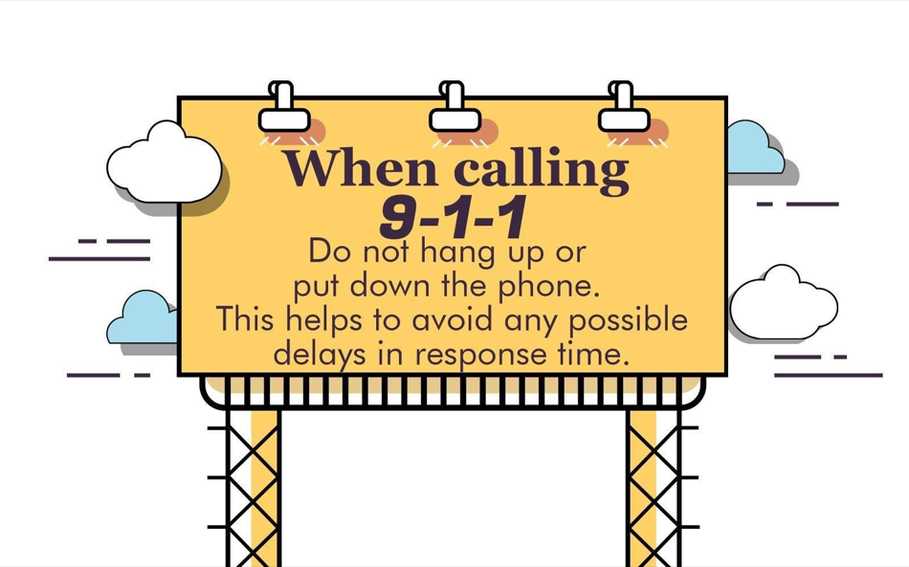
SPRING VALLEY POLICE DEPARTMENT
HILSHIRE VILLAGE
COMMUNITY MATTERS.
WE ARE A TEAM.
1025 CAMPBELL ROAD, HOUSTON, TX 77055
PHONE: 713-465-8323 / EMAIL: DISPATCH@SPRINGVALLEYTX.COM

Slide 6
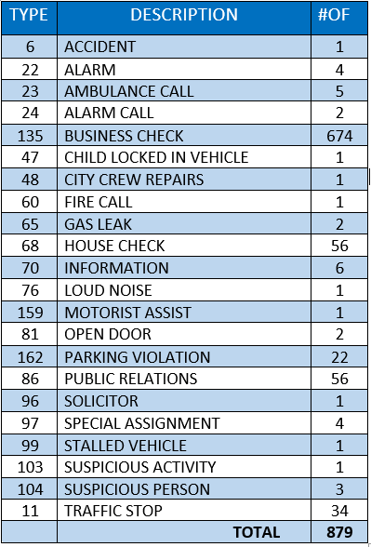
SPRING VALLEY POLICE DEPARTMENT
HILSHIRE VILLAGE
CALLS BY TYPE: 10-01-2024 THRU 10-31-2024
COMMUNITY MATTERS.
WE ARE A TEAM.
1025 CAMPBELL ROAD, HOUSTON, TX 77055
PHONE: 713-465-8323 / EMAIL: DISPATCH@SPRINGVALLEYTX.COM

Slide 7
NOVEMBER AWARENESS:
COLON CANCER
Awareness Month
COMMUNITY MATTERS.
WE ARE A TEAM.
1025 CAMPBELL ROAD, HOUSTON, TX 77055 / PHONE: 713-465-8323 / EMAIL: DISPATCH@SPRINGVALLEYTX.COM

Slide 8
IMPORTANT NUMBERS AT A GLANCE
EMERGENCY |  | NON - EMERGENCY
911 - FOR ALL EMERGENCY |  | 713-465-8323
988 – NATIONAL SUICIDE & MENTAL HEALTH
SPRING VALLEY VILLAGE |  | VILLAGE FIRE DEPARTMENT
SPRING VALLEY - CITY HALL | 713-465-8308 | VILLAGE FIRE DEPARTMENT |  | 713-465-2323
SPRING VALLEY - PD | 713-465-8323 | VFD - NON-EMERGENCY |  | 713-468-7941
SPRING VALLEY - PD FAX | 713-465-3135
SPRING VALLEY - COURT | 713-465-0333
HILSHIRE VILLAGE
HILSHIRE VILLAGE – CITY HALL | 713-973-1779
COMMUNITY MATTERS.
WE ARE A TEAM.
1025 CAMPBELL ROAD, HOUSTON, TX 77055 / PHONE: 713-465-8323 / EMAIL: DISPATCH@SPRINGVALLEYTX.COM

